Slide 1
Digital clock
submitted by:
G.Sridhar
p. manoj kumar
G.harshini

Slide 2
Index
Introduction
Components used
Working mechanism
Advantages of Digital clock
Disadvantages of Digital clock
Applications

Slide 3
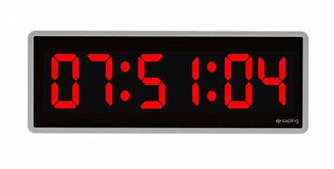
introduction
A Digital clock is a type of clock that displays the time digitally, as opposed to an analog clock, where the time is indicated by the positions of rotating hands.
To represent the time, most digital clock use a seven segment LED(light emitting display) or LCD for each of six digits.

Slide 4
history
The first digital pocket watch was the invention of Australian engineer Josef Pallweber who created his “jump-hour” mechanism in 1883.
The earliest patent for a digital alarm clock was registered by D.E Protzmann and others on October 23, 1956, in the United states.
The Hamilton watch company introduced the first digital wristwatch that included an LED display in 1970.

Slide 5
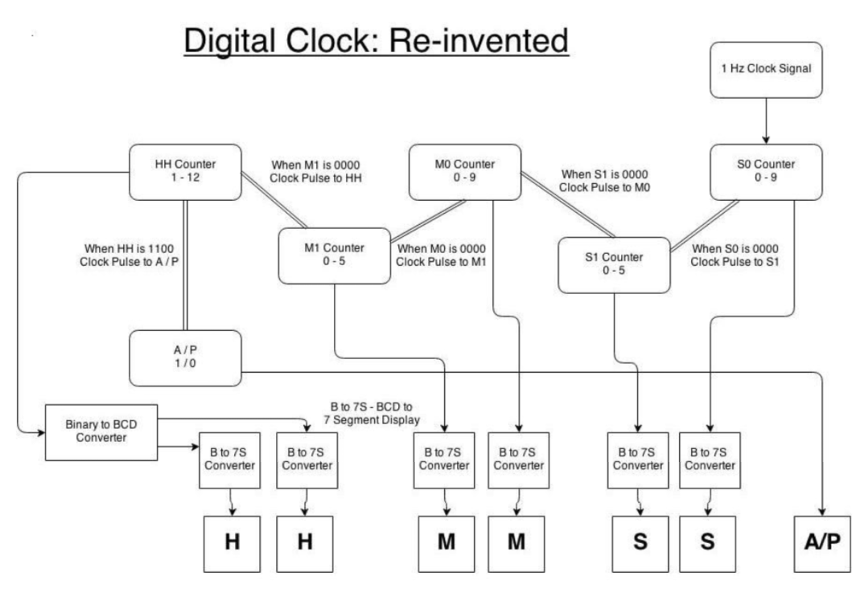
Digital clock logic

Slide 6
Components used
555 timer
IC 4026
7 segment display
IC 7411(3-input NAND gate)
Capacitor
Resistors

Slide 7
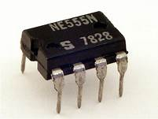
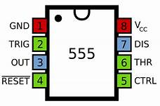
555 timer
The 555 timer is an integrated circuit used in a variety of timer, pulse generation and oscillator applications.
The 555 can be used to provide time delays, as an oscillator, and as a Flip-flop element.

Slide 8
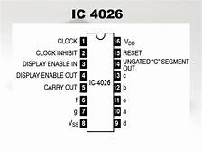
Ic 4026
IC 4026 is a 16-pin CMOS seven segment.
It counts clock pulses and returns the output in a form which can be displayed on a 7-segment display.
It is decode counter IC with decoded outputs for driving a 7-segment LED display.

Slide 9
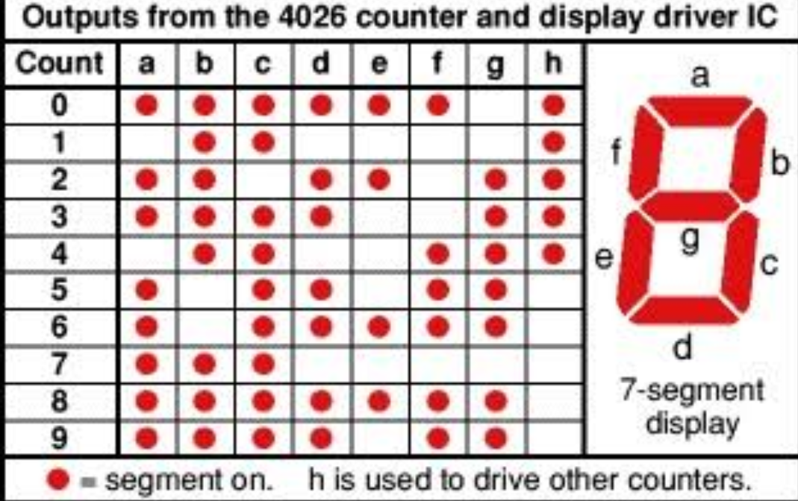
Truth table

Slide 10
7-segment display
An LED is a solid state optical PN-junction diode which emits light energy in the form of photons.
It occurs only in forward biased by an external voltage allowing current to flow across its junction.
7-segment display consists of seven LEDs arranged in rectangular fashion.
Pair of seven LEDs is called a segment.
As LED has 2 connecting pins, are Anode, Cathode.

Slide 11
Types of 7-segment display
There are two types of LED 7-segment display, they are:
Common Cathode display
Common Anode display
The common cathode has all the cathodes of seven segment display connected directly together
The common anode has all the anodes of the seven segments connected together.
In this experiment either common cathode or common anode can be used.
Here in practical we using common cathode display.

Slide 12
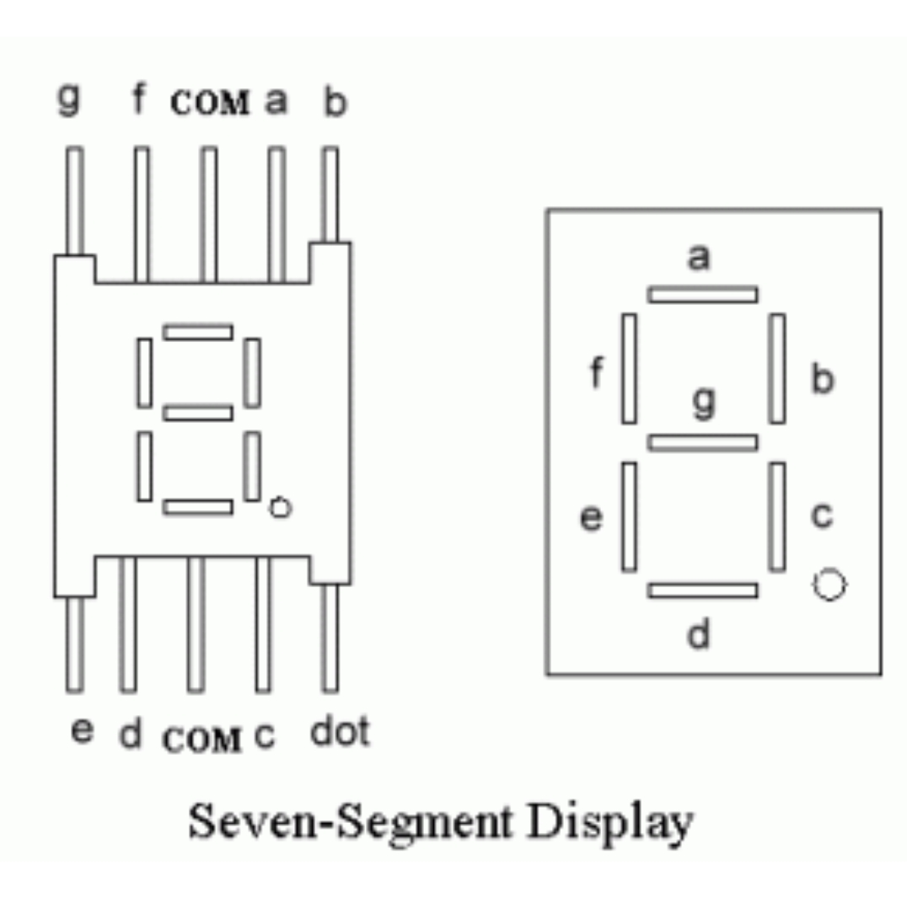
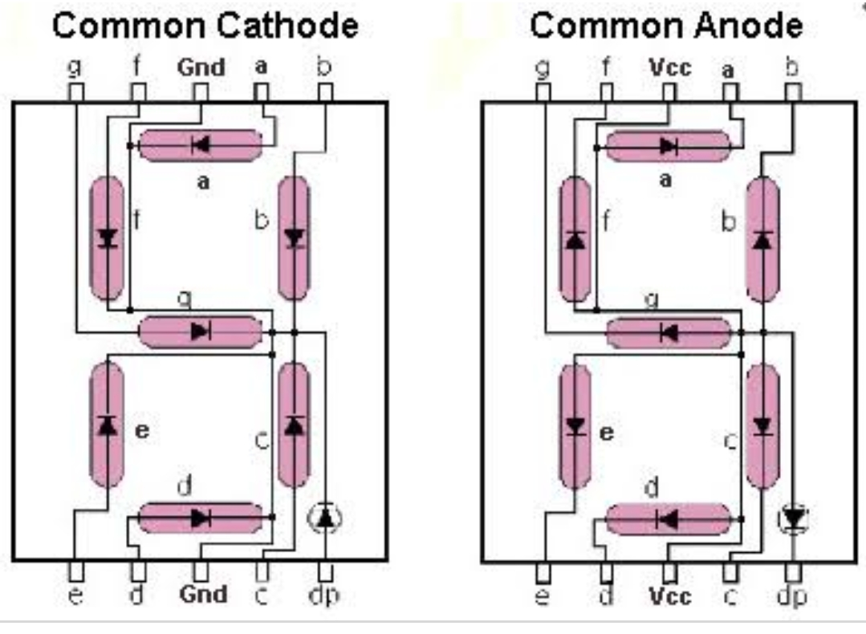

Slide 13
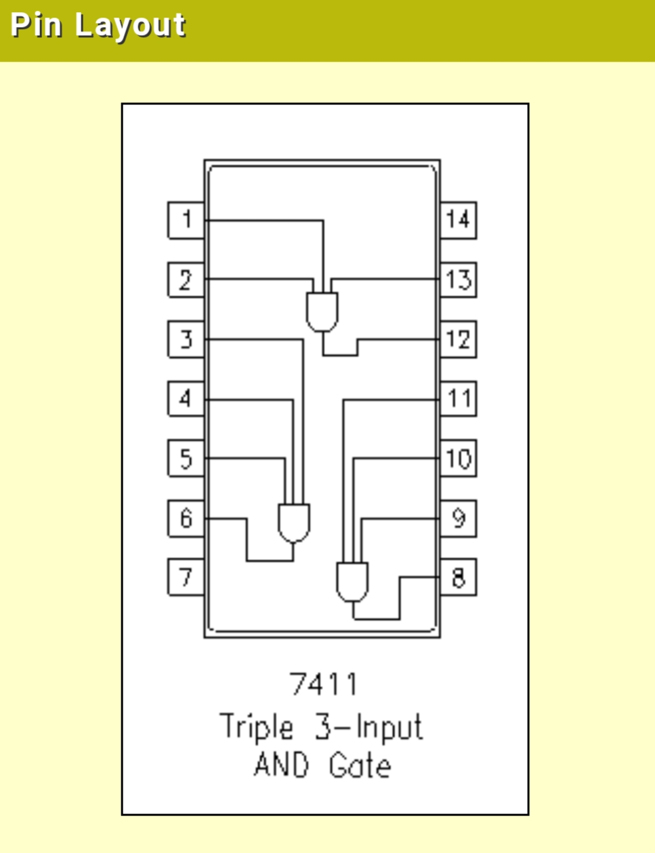
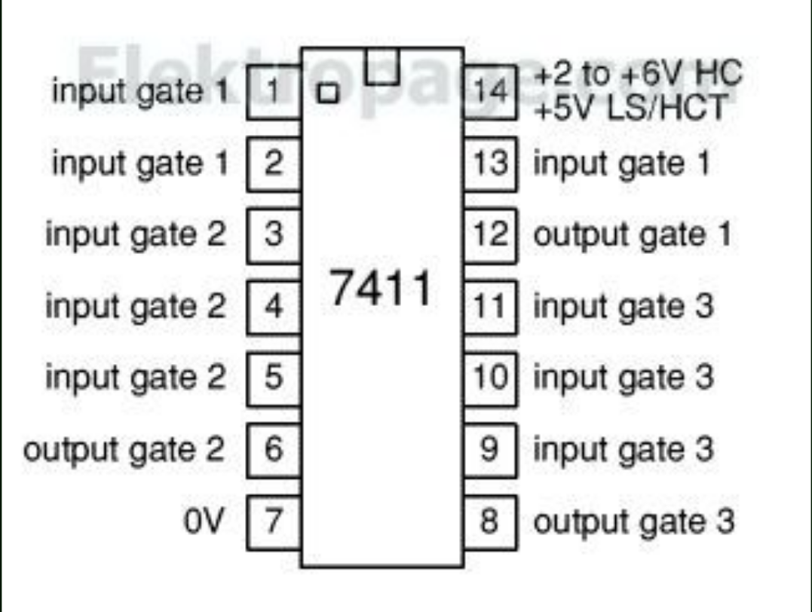
Ic 7411
IC 7411 is a three input AND gate.
If all inputs are high the output will be high.

Slide 14
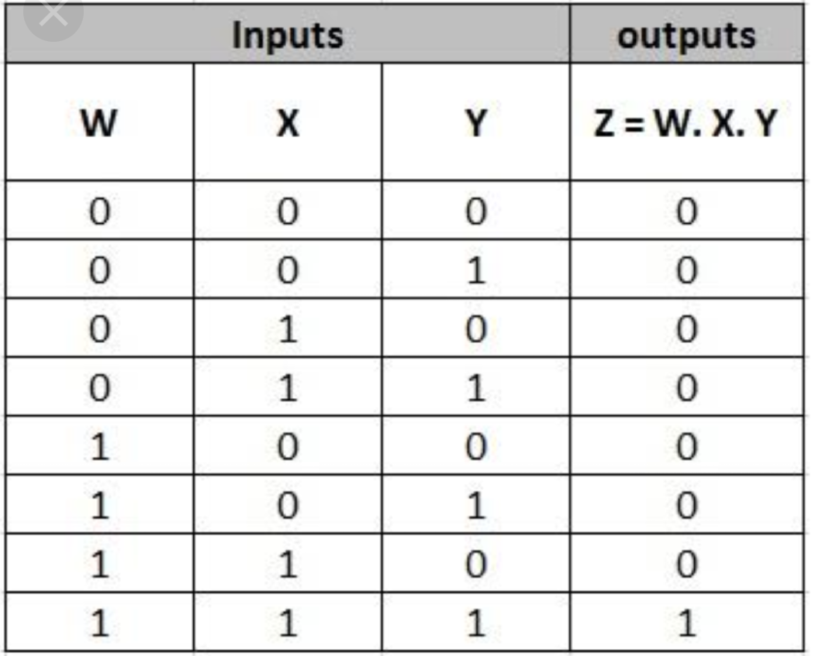
Truth table

Slide 15
Capacitor and resistor
Capacitor is a two terminal electronic component that stores electrical energy in an electric field.
Resistor is a two terminal electrical component that implements electrical resistance in circuit.
Resistors are used to reduce current flow, adjust signal levels to divide voltages.
High power resistors that can dissipate many watts of electrical power as heat

Slide 16
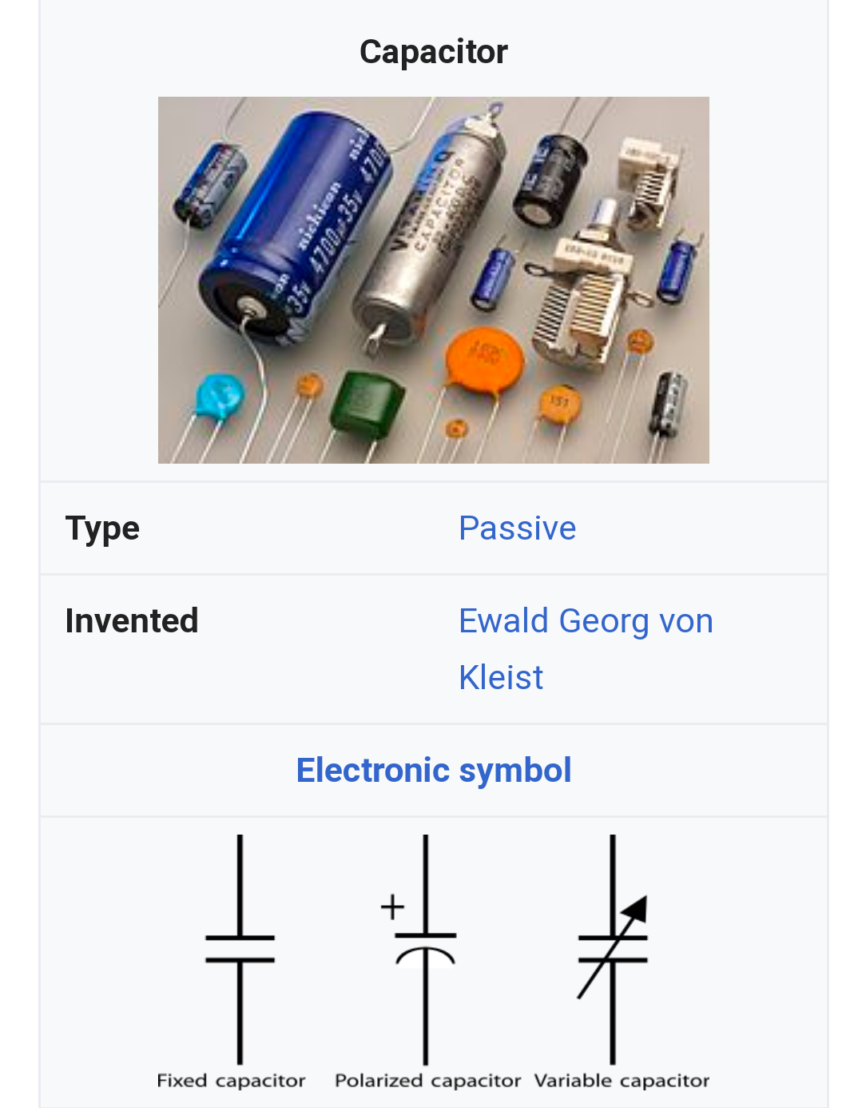
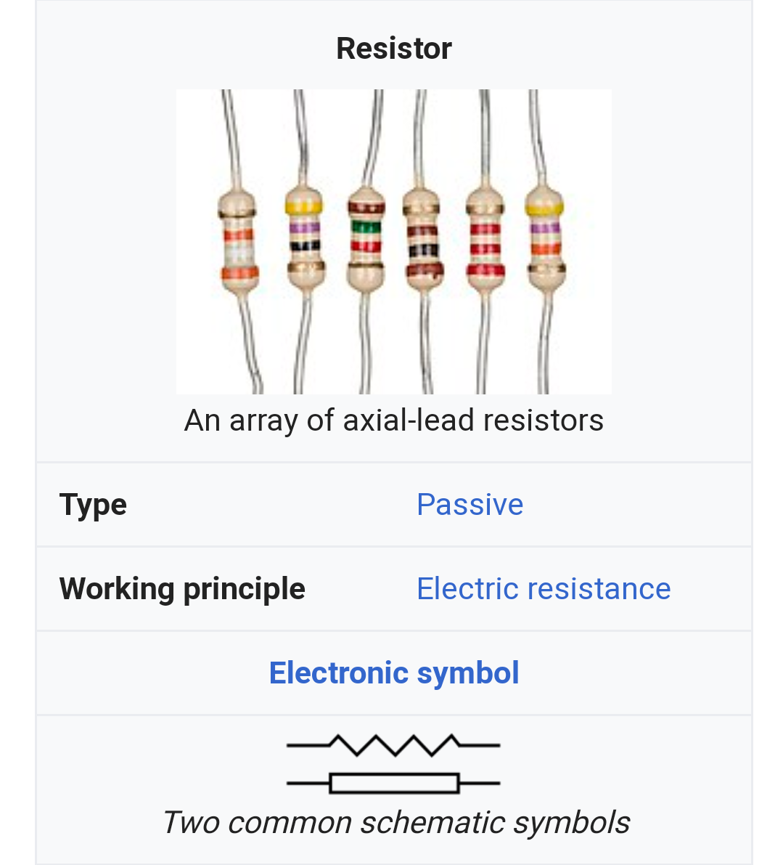

Slide 17
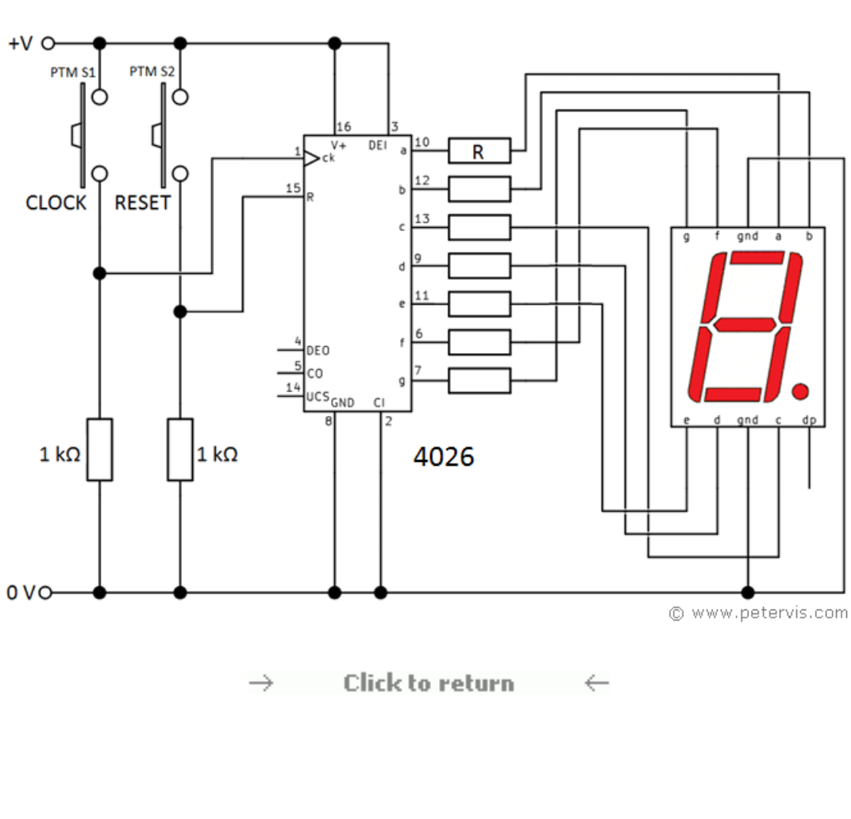
Working mechanism
The 555 timer generate clock pulse after a second and output of 555 is connected to pin 1 of IC 4026 which is a 7 segment display decade counter which is used to drive a 7 segment display with input clock pulse.

Slide 18
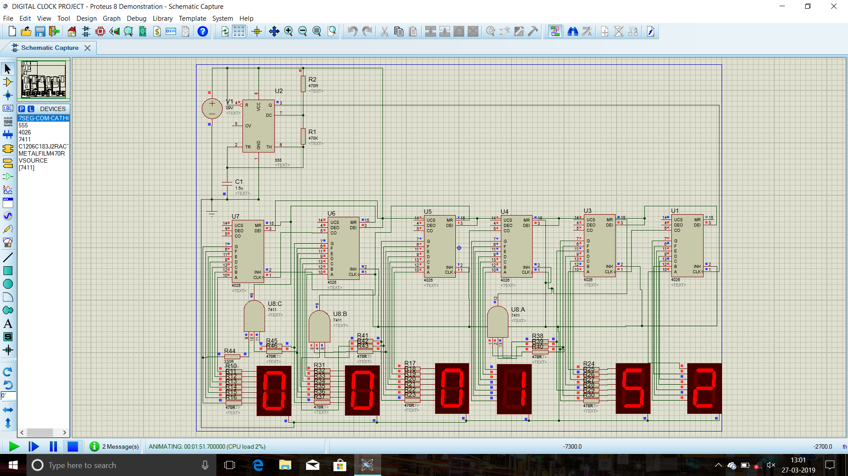
Software snapshot

Slide 19
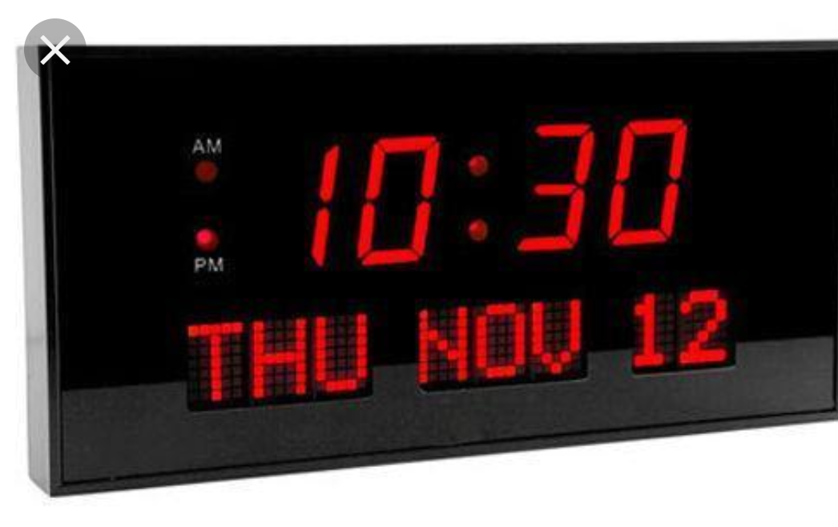
Advantages of digital clock
Less expensive.
Easy to understand time concept.
Give time more accurately than analog clock.
Easier to understand time.
It is indication of an absolutely exact time.
The accuracy of timings exactly provided.

Slide 20
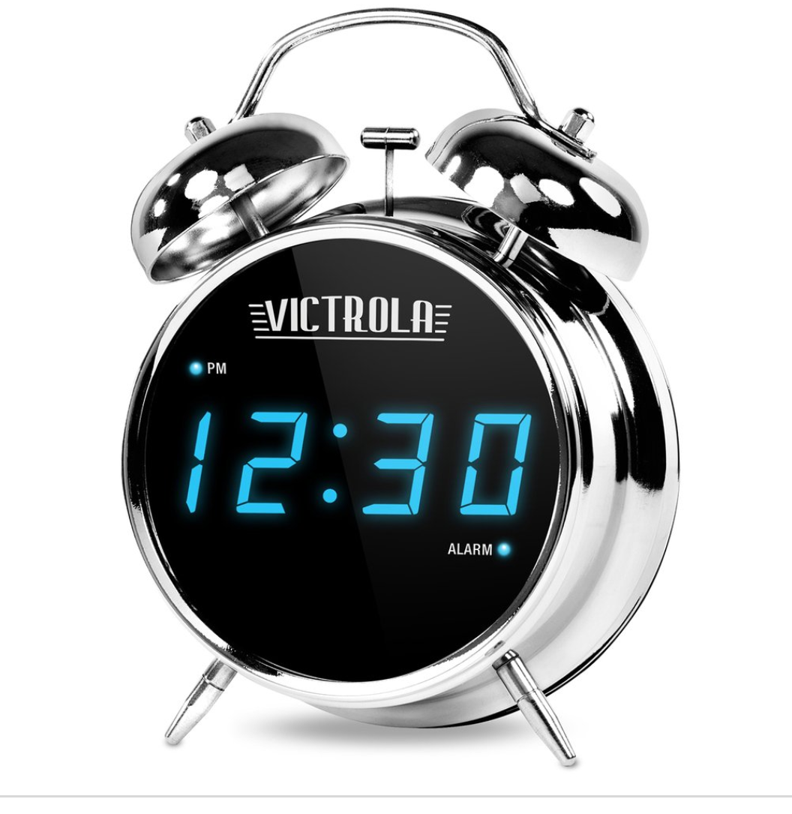
disadvantages
They depend on electricity and batteries.
Discrete values thus bit errors occurs.
Can’t exactly represent original analog.
Some of them react with temperature changes.

Slide 21
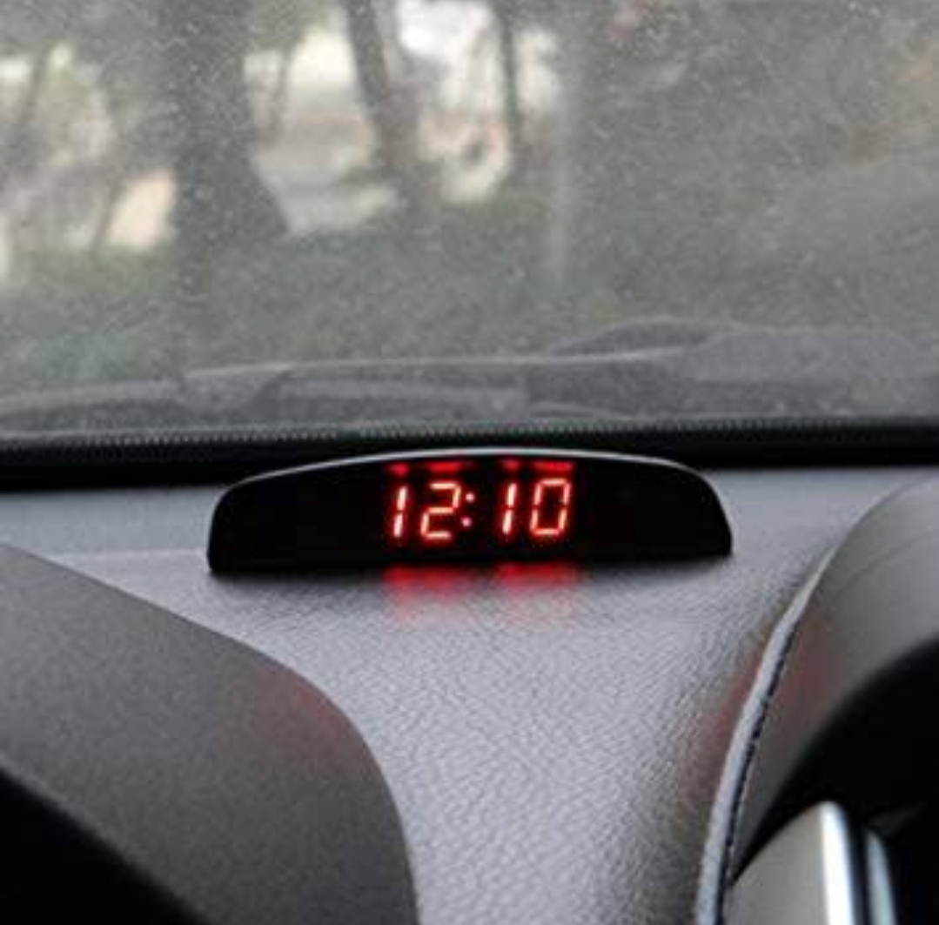
applications
Digital clocks are used in different kinds of devices such as cars, radios, television, microwave ovens, computers, mobiles etc.
They are used in several applications.
Now a days digital clocks are used in any places.

Slide 22
Thank you
for spending
your precious time
Submitted to:
Ajmer singh sir

